Slide 2




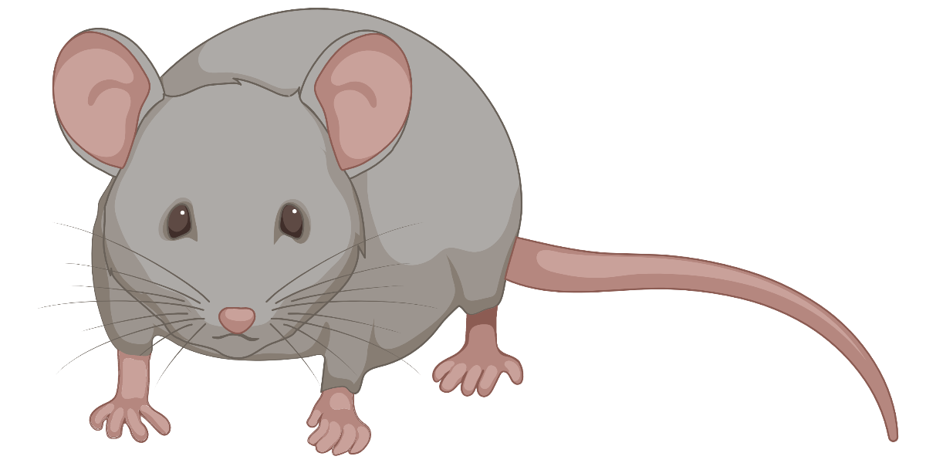
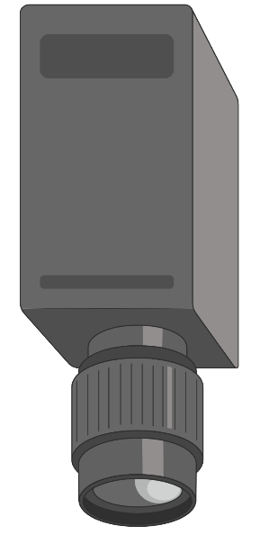
Experimental Design
1. Identify the Different Functional Cell Group
2. Customization of SLM Power for Each Cell
3. Activate Functional Group of Cells Under Different Behaviors
Voluntary locomotion
Light anesthesia
2p Imaging
Quick analysis
2p Imaging + Single cell stimulation ~20 min
Quick analysis
Identify the SLM parameters for each single cell
2P imaging + Holographic photo-stimulation and whisker stimulation
2P imaging + Holographic photo-stimulation and whisker stimulation
Bruker_PrairieLink
Bruker_PVLinkExcuteFolder
Bruker_PVLinkExcuteFolder
2-PT Ca²⁺
imaging
2-PT Ca²⁺
Imaging + SLM
2-PT Ca²⁺
Imaging +
SLM
Motion encoder
Locomotion (L) speed
WM
L
IR imaging
Whisker motion (WM)
Whisker
stimulation
Whisker
stimulation

Slide 3
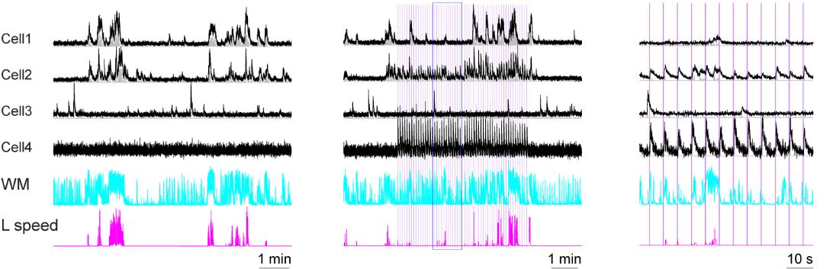
Experimental Design
1. Identify the Different Functional Cell Group
2. Customization of SLM Power for Each Cell
3. Activate Functional Group of Cells Under Different Behaviors
Cell target
Non-cell target
Spontaneous behaviors
Whisker stimulation
Locomotion cells
Whisking and locomotion cells (WL cells)
Sensory cells (S cells)
Which cells to target
Where to target

Slide 4
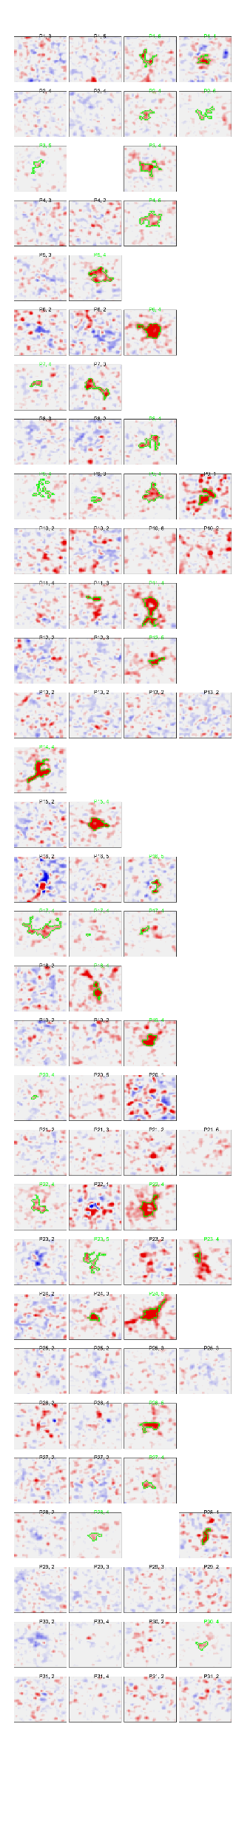
Experimental Design
1. Identify the Different Functional Cell Group
2. Customization of SLM Power for Each Cell
3. Activate Functional Group of Cells Under Different Behaviors
1. Reduce variation of SLM response across cells
2. Identify some functional connections at single cell level
Cell 1
Cell 2
Cell 3
Cell 4
40 x 40 pixels response map, where SLM target is at the centers ( diameter: ~ 15 pixels )
Inhibited
Enhanced
SLM power levels

Slide 5
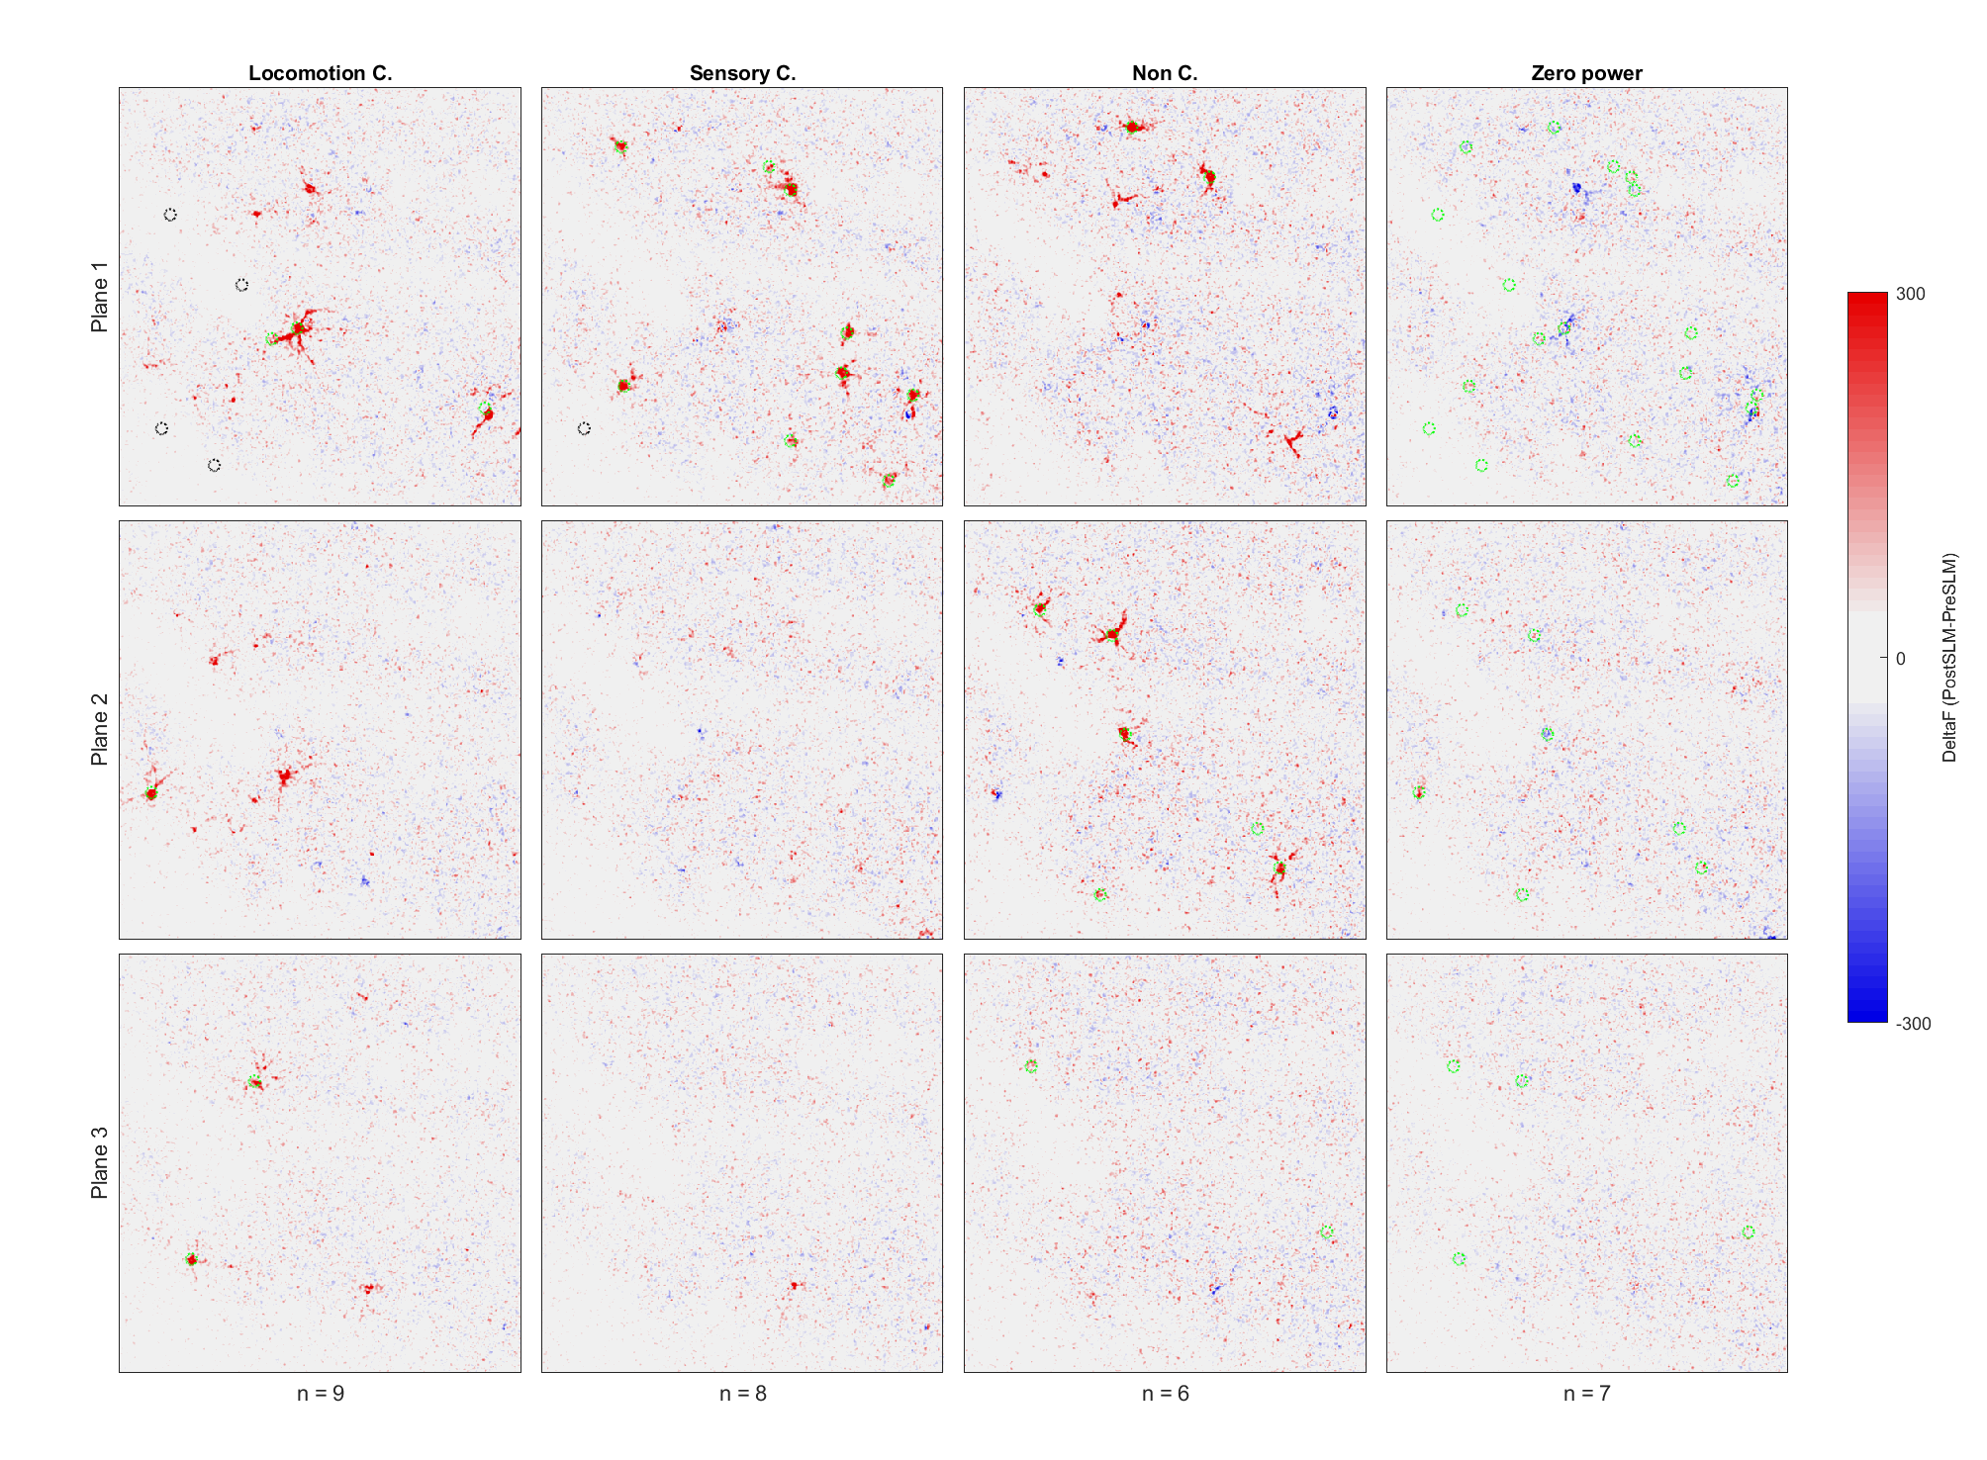
Experimental Design
1. Identify the Different Functional Cell Group
2. Customization of SLM Power for Each Cell
3. Activate Functional Group of Cells Under Different Behaviors

Slide 6
Network Impact Across Different Conditions
Cell Groups (Locomotion, Sensory, Non-LS) × 3 Behavior States (spontaneous running, spontaneous staying and anesthesia) × 2 Stimuli (SLM with whisker vs SLM without whisker) × 2 Powers (Zero SLM power vs non-zero power).
Inhibited
Enhanced

Slide 7
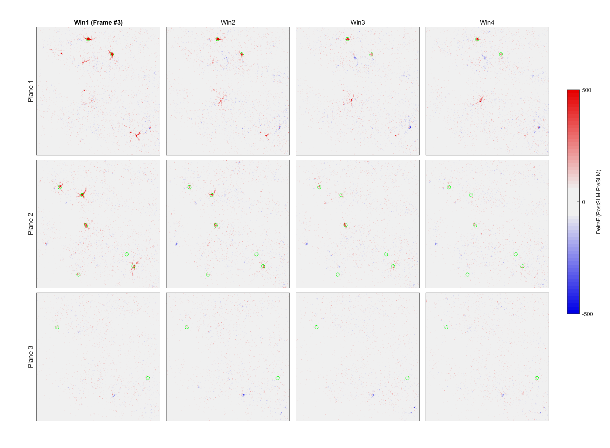
Dynamic Network Impact
Time windows
Recording Planes

Slide 8

Holographic Imaging and Photo-Stimulation
To ensure each cell has comparable response
Data for analysis
Data for analysis
2p Imaging ~20 min
Quick analysis
2p Imaging + Single cell stimulation ~20 min
Quick analysis
Identify the SLM parameters for each single cell
2P imaging + Holographic photo-stimulation
Data for future offline analysis
Bruker_PrairieLink
Bruker_PVLinkExcuteFolder
Bruker_PVLinkExcuteFolder
Continuous imaging sequence
Pause for SLM in imaging sequence
Data flow
Data flow
Frame 1
Frame 1
Frame 2
Frame 2
Frame 3
Frame 3
Pixels shift after SLM

Slide 9
Holographic Imaging and Photo-Stimulation
Plan B
To ensure each cell has comparable response
Data for analysis
Data for analysis
2p Imaging ~20 min
Quick analysis
2p Imaging + Single cell stimulation ~20 min
Quick analysis
Identify the SLM parameters for each single cell
2P imaging + Holographic photo-stimulation
Data for future offline analysis
Bruker_PrairieLink
Bruker_PVLinkExcuteFolder
Bruker_PVLinkExcuteFolder
Worked but not perfect
Continuous imaging sequence
Pause for SLM in imaging sequence
Data flow
Data flow
Precisely identify the last frame X before SLM
Frame 1
Frame X
Frame 2
Frame 3
Frame X+1
Frame X+2

Slide 10
Bruker TSeries Recording
Continuous imaging sequence
Data flow
No SLM
Iterate 1
Iterate 2
Iterate 3
Iterate 4
Iterate 5
Frame 1
Frame 2
Frame 3
Frame 4
Frame 5
Code original from Lloyd Russell 2017
Frame 1
Frame 2
Frame 3
Frame 4
Frame 5
Noted that, it is possible that during one specific iteration (occurs randomly) from Bruker->MATLAB data reading, the sample size is 0, even during continuous recording; But it is very rare that such case occurs continuously twice. (when I say “rare” means I never saw that).
Pause for SLM
Data flow
SLM
Iterate 1
Iterate 2
Iterate 3
Iterate 5
Frame 1
Frame 2
Frame 3
Frame 4
Frame 5
Frame 1
Frame 2
Frame 3
Frame 4
Redundant data detected, clean the buffer; Pause the data processing till new data coming.

Slide 11
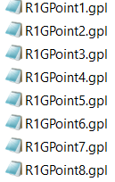
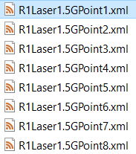
Bruker TSeries Recording, 1 SLM Trial/File
SLM shutter closed
One recording file (session) = One trial
Data flow
Imaging 50 frames -> SLM -> Imaging 20 frames
Frame 49
Frame 50
Frame 51
Frame 52
The holographic stimulation pattern in this recording is predefined by a pair of setting files: (.gpl file and a .xml file. )
Loop through a pre-defined file lists, could automatically executed in MATLAB controlled PV-Link environment for any the experiments design.
This works power customization of single cell SLM power

Slide 12
Bruker TSeries Recording, 1 SLM Trial/File
SLM shutter closed
One recording file (session) = One trial
Data flow
Imaging 50 frames -> SLM -> Imaging 20 frames
Loop through a pre-defined file lists, could automatically executed any the experiments design.
Frame 49
Frame 50
Frame 51
Frame 52
The holographic stimulation pattern in this recording is predefined by a pair of setting files: (.gpl file and a .xml file. )
This works power customization of single cell SLM power. However, 1SLM/File strategy is not ideal for continuous recording while randomly activate different functional group of cells

Slide 13
Bruker TSeries Recording, 1 SLM Trial/File
One recording file (session) = 5 trials in following example, a pre sequence of imagings is defined (50, 80, 40, 60, 30, 30) frames
50 frames -> SLM -> 80 frames -> SLM -> 40 frames -> SLM -> 60 frames -> SLM -> 30 frames -> SLM -> 30 frames
Group 1 Targets
Group 2 Targets
Group 1 Targets
Group 1 Targets, sham stimuli (power = 0)
Group 2 Targets
Loop through a pre-defined file lists, could automatically executed in MATLAB controlled PV-Link environment for any the experiments design.
This works power customization of single cell SLM power. However, 1SLM/File strategy is not ideal for continuous recording while randomly activate different functional group of cells

Slide 14
Bruker -> MATLAB Data Flows
Continuous imaging sequence
Data flow
No SLM
Iterate 1
Iterate 2
Iterate 3
Iterate 4
Iterate 5
Frame 1
Frame 2
Frame 3
Frame 4
Frame 5
Code original from Lloyd Russell 2017
Frame 1
Frame 2
Frame 3
Frame 4
Frame 5
Noted that, it is possible that during one specific iteration (occurs randomly) from Bruker->MATLAB data reading, the sample size is 0, even during continuous recording; But it is very rare that such case occurs continuously twice. (when I say “rare” means I never saw that).
Pause for SLM
Data flow
SLM
Iterate 1
Iterate 2
Iterate 3
Iterate 5
Frame 1
Frame 2
Frame 3
Frame 4
Frame 5
Frame 1
Frame 2
Frame 3
Frame 4
Redundant data detected, clean the buffer; Pause the data processing till new data coming.

